Slide 1
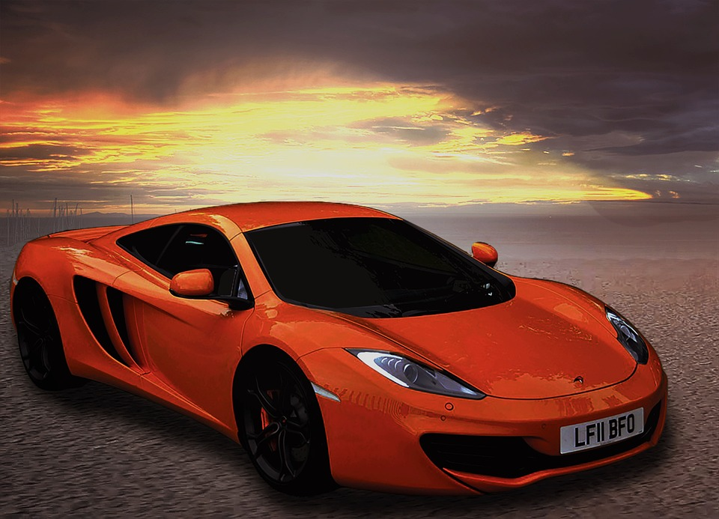
Analyzing the Impact of Car Features on Price and Profitability
Final Project-3
By – Anindya Das

Slide 2
Project Description:
The automotive industry is undergoing significant changes due to fuel efficiency, environmental concerns, and technological advancements. Understanding consumer demand is essential for manufacturers aiming for long-term success.
This project will analyze the relationship between a car's features, market category, and pricing to identify key factors influencing profitability and consumer demand. Our client, a leading car manufacturer, asks: How can we set prices and develop products to boost profitability while meeting consumer needs?

Slide 3
Approach:
Explore trends in-car features and pricing over time.
Analyze the relationship between engine power, fuel efficiency, and pricing.
Identify the most important features influencing a car's price
Examine pricing variations across manufacturers and market categories.
Develop an interactive dashboard to visualize the findings.
By leveraging advanced Excel skills, regression analysis, and data visualization techniques, we aim to provide valuable insights to support informed pricing and product development decisions.
This presentation structure provides an overview of the project, outlines the problem statement, describes the dataset, and explains the analysis approach. It sets the stage for the subsequent slides, which will delve into the specific analyses, findings, and recommendations

Slide 4
Tech-Stack Used:
Microsoft Excel: Used for data analysis, manipulation, and visualization. Excel provides various functionalities for working with data, including formulas, charts, and pivot tables.
Microsoft Excel

Slide 5
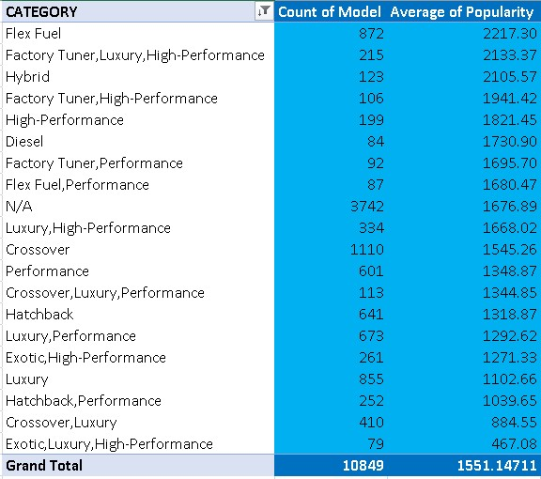
Analysis
TASK 1 – POPULARITY OF CAR MODEL:
A: Create a pivot table that shows the number of car models in each market category and their corresponding popularity scores.
Insight : Top 20 Market Category Popularity of Cars

Slide 6
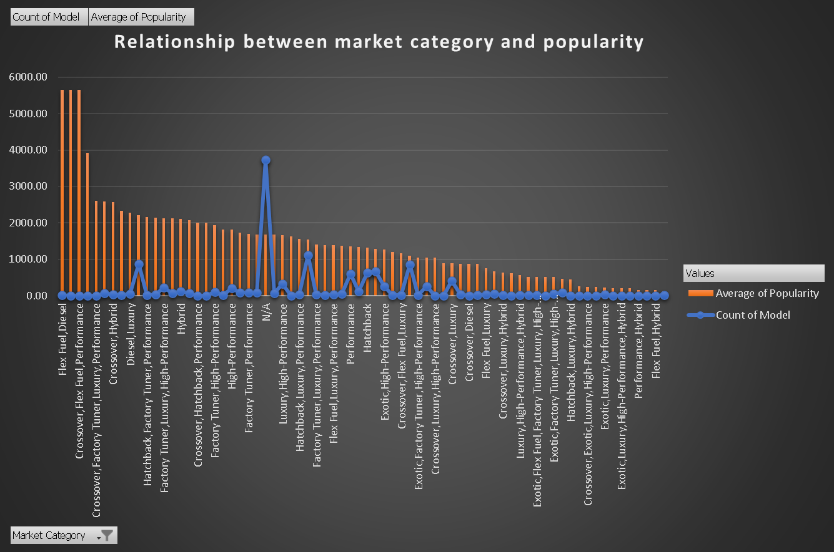
TASK 1 – POPULARITY OF CAR MODEL:
B: Create a combo chart that visualizes the relationship between market category and popularity.
Insight : The Most Popular Category of Cars is Hatchback, Flex Fuel/Diesel, Crossover, and Luxury Cars.

Slide 7
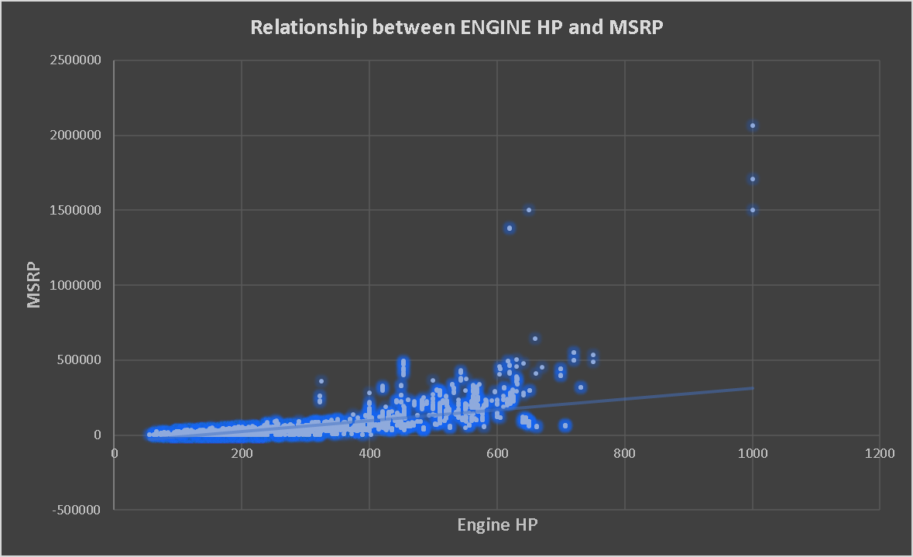
TASK 2 - RELATIONSHIP BETWEEN A CAR'S ENGINE POWER AND ITS PRICE?
Task : Create a scatter chart that plots engine power on the x-axis and price on the y-axis. Add a trendline to the chart to visualize the relationship between these variables.
Insight : Below is the Scatter Chart Plot which shows that as the Engine Power i.e HP Increases Prices also increases and can say that it is directly proportional.

Slide 8
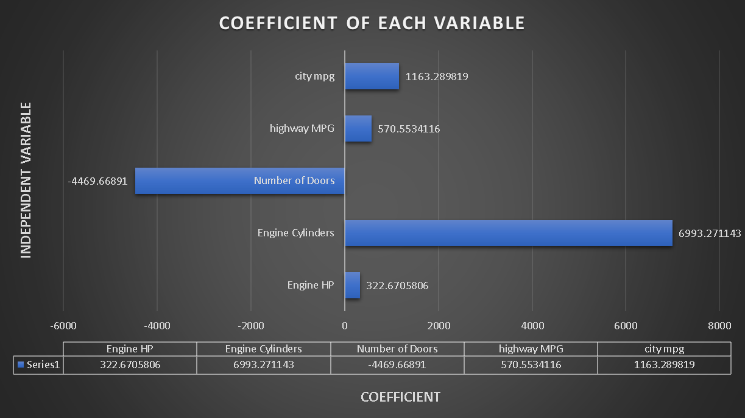
TASK 3 -WHICH FEATURES ARE MOST IMPORTANT FOR DETERMINING PRICE?
Task : Use regression analysis to identify the variables that have the strongest relationship with a car's price. Then create a bar chart that shows the coefficient values for each variable to visualize their relative importance.
Insight: The Features which is important with respect to price are Engine Cylinders, city mpg and the Least is number of doors. That is why Cars which are expensive like Sports Car are the Costliest.

Slide 9
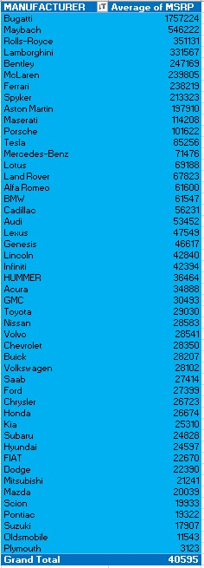
TASK 4 - AVERAGE PRICE BY MANUFACTURER
A: Create a pivot table that shows the average price of cars for each manufacturer.
Insight : Bugatti is the Most Expensive Car Maker by Average Price.

Slide 10
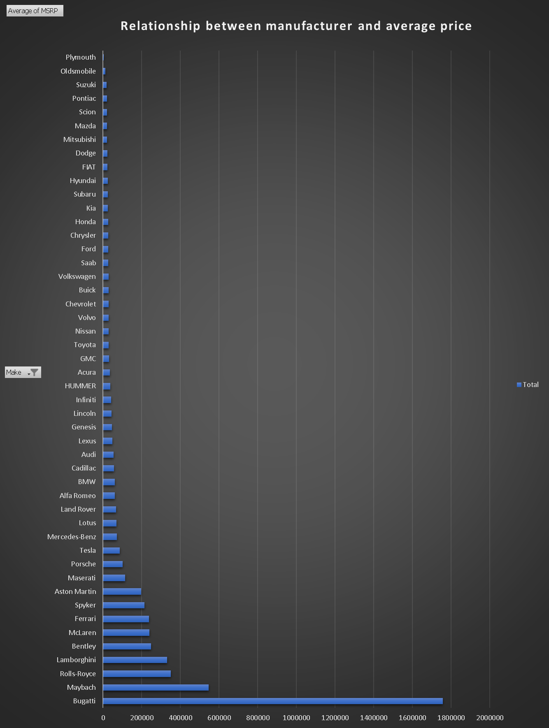
TASK 4 - AVERAGE PRICE BY MANUFACTURER
B: Create a bar chart or a horizontal stacked bar chart that visualizes the relationship between the manufacturer and the average price.
Insight : As per the Analysis, Bugatti has the Most Expensive Average Price of Cars followed by Maybach, Rolls-Royce and the Least expensive Plymouth, Suzuki

Slide 11
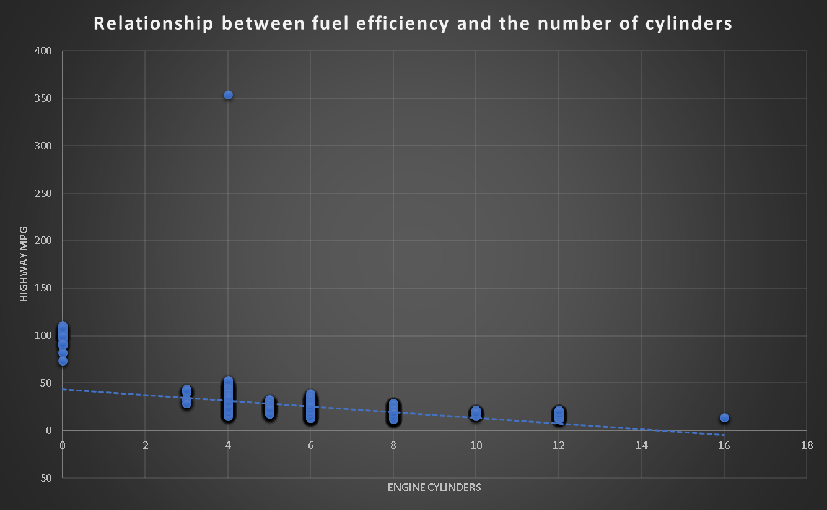
TASK 5- RELATIONSHIP BETWEEN FUEL EFFICIENCY AND ENGINE CYLINDERS
A: Create a scatter plot with the number of cylinders on the x-axis and highway MPG on the y-axis. Then create a trendline on the scatter plot to visually estimate the slope of the relationship and assess its significance
Insight : As per the Analysis, When the Engine Cylinders are Higher than the Highway MPG is Lower because More Cylinders More Powerful Engine thus Lower MPG

Slide 12

TASK 5- RELATIONSHIP BETWEEN FUEL EFFICIENCY AND ENGINE CYLINDERS
B: Calculate the correlation coefficient between the number of cylinders and highway MPG to quantify the strength and direction of the relationship.
Insight: Correlation Coefficient is {-0.621605733}

Slide 13
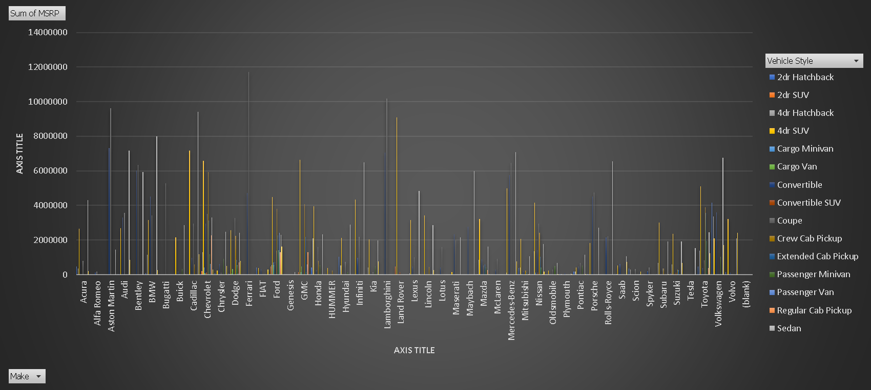
Building the Dashboard:
Task 1: How does the distribution of car prices vary by brand and body style?

Slide 14
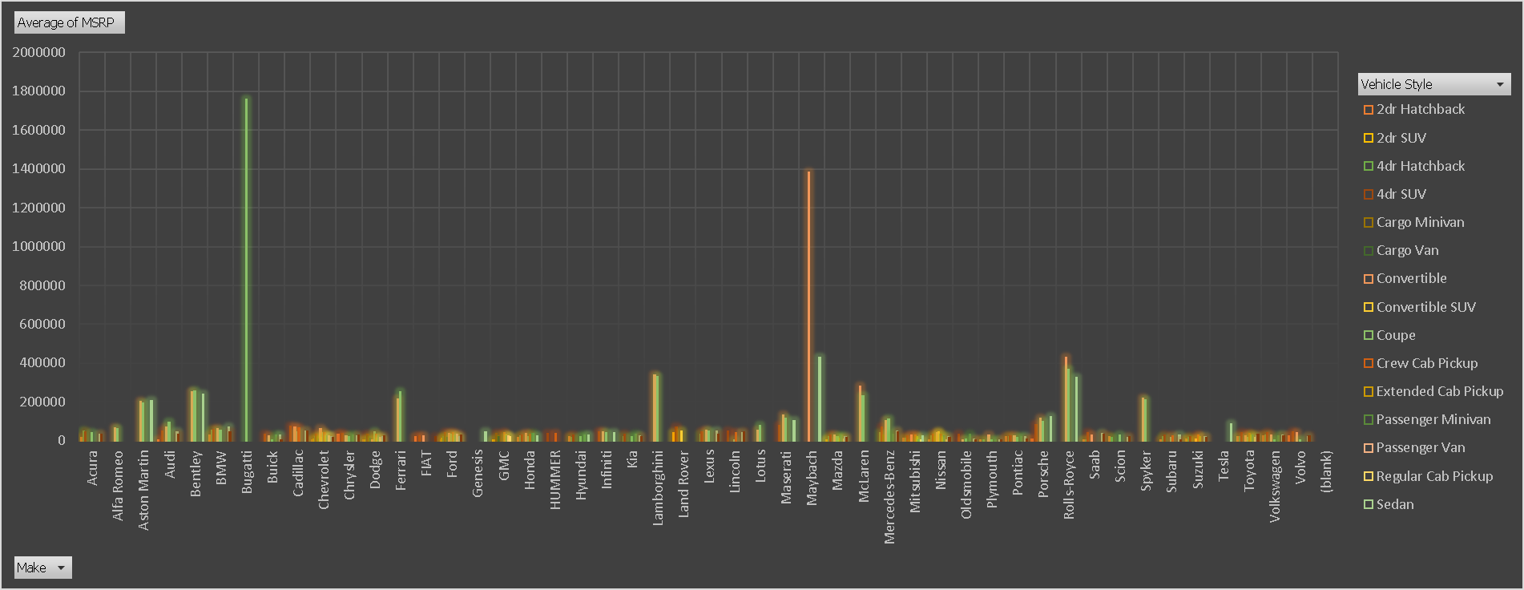
Task 2: Which car brands have the highest and lowest average MSRPs, and how does this vary by body style?

Slide 15
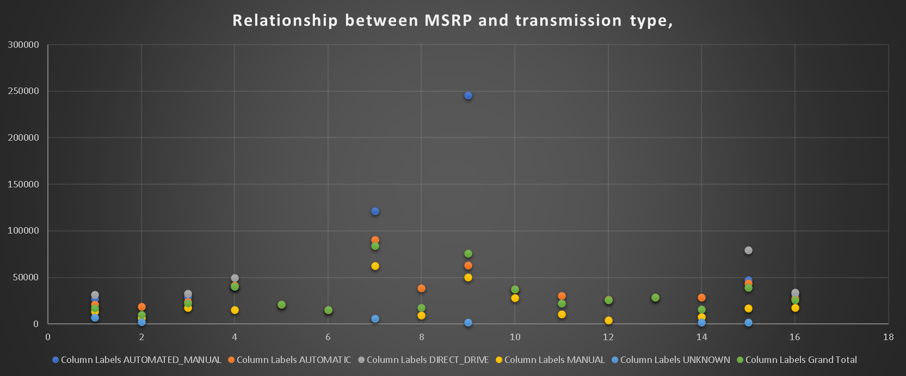
Task 3: How do the different features such as transmission type affect the MSRP, and how does this vary by body style?

Slide 16
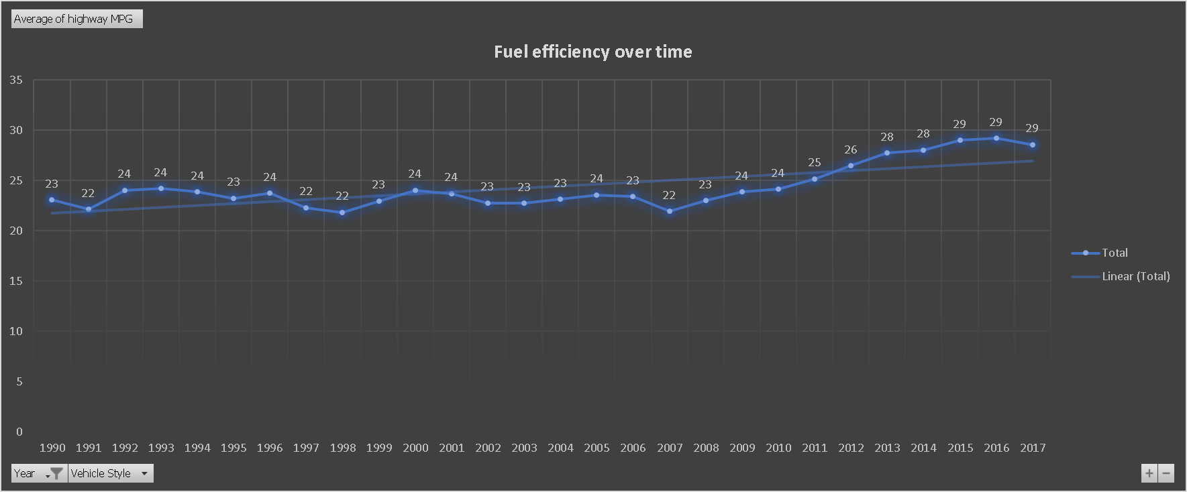
Task 4: How does the fuel efficiency of cars vary across different body styles and model years?

Slide 17
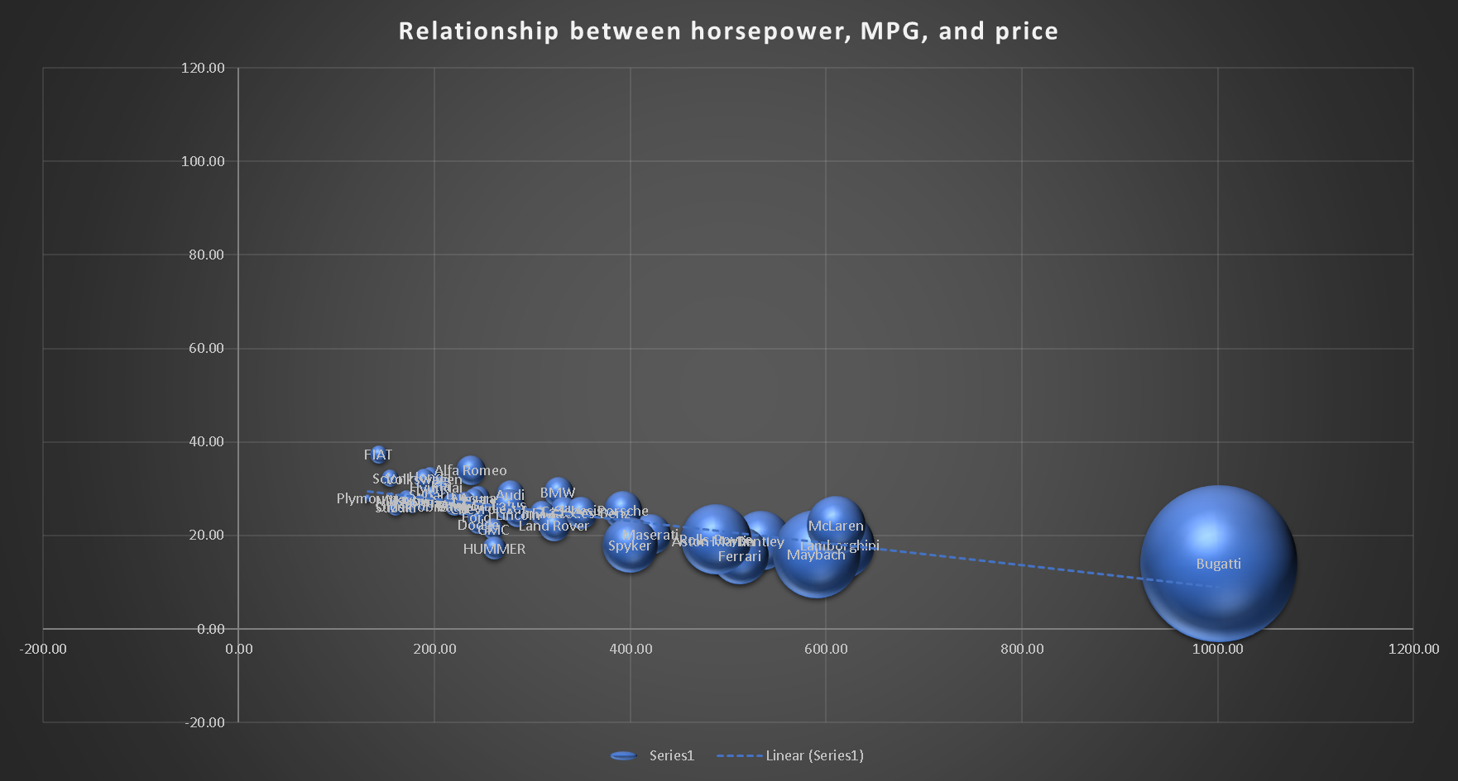
Task 5: How do the car's horsepower, MPG, and price vary across different Brands?

Slide 18
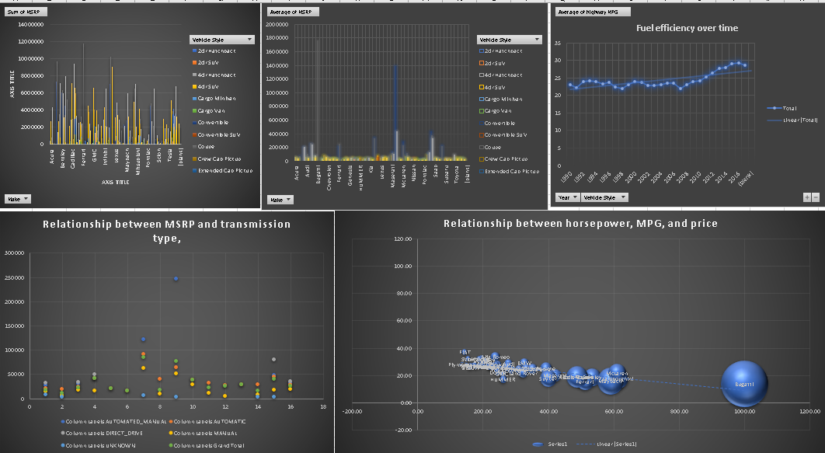

Slide 19
RESULT
Popular Car Categories: The most popular categories of cars based on our analysis are Hatchback, Flex Fuel/Diesel, Crossover, and Luxury Cars.
Price and Engine Power Relationship: There is a direct proportionality between engine power (Horse Power) and car prices. As engine power increases, so do prices, indicating that consumers are willing to pay more for higher performance.
Key Features Impacting Price: The most important features influencing car prices are Engine Cylinders and city milage, followed by number of doors. This explains why cars with expensive features like Sports Cars tend to be the costliest.
Average Price by Manufacturer: Bugatti emerges as the most expensive car maker with an average price of USD 1,757,224, while Plymouth offers the cheapest cars with an average price of USD 3,297.
Engine Cylinders and MPG: Analysis reveals that as engine cylinders increase, highway MPG decreases. This is because higher cylinder counts typically indicate more powerful engines, resulting in lower fuel efficiency.

Slide 20
RESULT
Popular Car Category and Brand: Sedan is identified as the most popular car category, with Chevrolet being the most popular brand among consumers.
Performance and Efficiency: Bugatti boasts the highest HP with the lowest MPG, making it the most costly car maker. Conversely, Fiat has the lowest HP, while Alfa Romeo achieves the highest highway MPG. Plymouth stands out as the cheapest car maker overall.
In conclusion, these insights offer valuable guidance for car manufacturers in understanding consumer preferences, optimizing pricing strategies, and focusing on key features to meet market demands effectively.
DATASET: https://docs.google.com/spreadsheets/d/1LEhjK717uSrxoZtQOUnbgiUdSf-Jk8h9/edit?usp=drive_link&ouid=100865564169059724511&rtpof=true&sd=true

Slide 21

Thank you!

